Slide 1
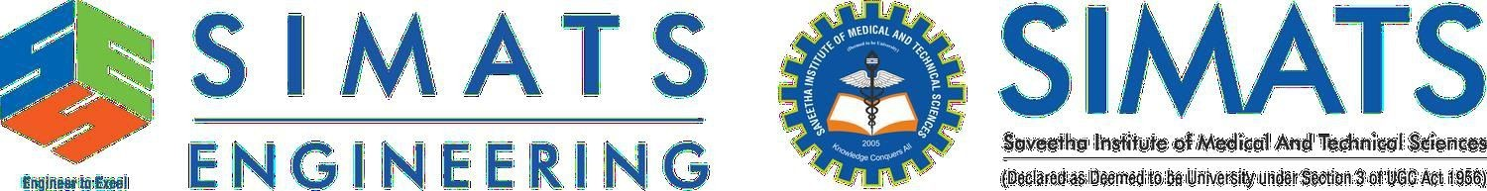
Cloud-Based Smart Warehouse Automation
Simulation-Based Intelligent Warehouse Automation System
CSA1501 cloud computing for
Presented by:
Guide By:
H. Harshavardhan (192511171) Ch . Abhilash Reddy (192525462)
Lingamguntla surya praneeth(192311233) Yannamani sarvarayudu(192324181)
Dr.M.D BOOMIJA
SSE, SIMATS Engineering
SSE, SIMATS Engineering

Slide 2
ABSTRACT
A cloud-deployable warehouse automation platform combining a FastAPI/PostgreSQL backend with core WMS operations, robotics, and an intelligence layer.
Real-time A* path planning with obstacle avoidance, cell-reservation collision detection, and priority-based conflict resolution drives autonomous robot navigation.
An explainable AI layer forecasts demand (WAPE/MAE/RMSE/sMAPE) and flags inventory shrinkage using Isolation Forest anomaly detection.
A Scenario Lab and Digital Twin let managers run reproducible what-if experiments, including OR-Tools optimized scheduling and SimPy discrete-event simulation.
Security is enforced through JWT/RBAC authentication, step-up OTP verification, and a hash-chained, tamper-evident audit ledger.
System health, metrics, and error tracking are exposed for full observability across every connected service.

Slide 3
INTRODUCTION
Manual and semi-automated warehouses struggle with robot congestion, unpredictable demand, and undetected inventory shrinkage.
This project builds a single integrated platform where core operations, robot automation, inventory intelligence, and warehouse security work together end to end.
A tick-based Digital Twin keeps a live, database-reconciled view of every robot, task, and obstacle in the warehouse.
Machine learning adds forecasting and anomaly detection on top of raw stock-movement data, so decisions are explainable, not black-box.
The system is built to be demoable and auditable: every simulation run is reproducible, every security-relevant action is logged to an immutable ledger.

Slide 4
OBJECTIVES
To build a complete warehouse operations core orders, inventory, transfers, and receiving as the foundation of the platform.
To secure the platform end to end with RBAC, step-up OTP authentication, and a hash-chained, tamper evident audit ledger.
To forecast product demand and detect inventory anomalies using explainable machine learning models.
To simulate a multi-robot fleet with A* path planning and a live Digital Twin, and expose AI-assisted decision support to managers.

Slide 5
MODULE 1: CORE WAREHOUSE OPERATIONS & INVENTORY MANAGEMENT
Manages the full order lifecycle creation, picking, packing, shipping, and delivery with validated state transitions.
Tracks inventory in real time with row-level locking to prevent race conditions during concurrent stock updates.
Supports inter-warehouse transfers, damage logging, and return workflows with full traceability.
Every stock movement is recorded against a single, database-verified source of truth.
Backed by an automated test suite covering order flows, inventory accuracy, and edge-case state transitions.

Slide 6


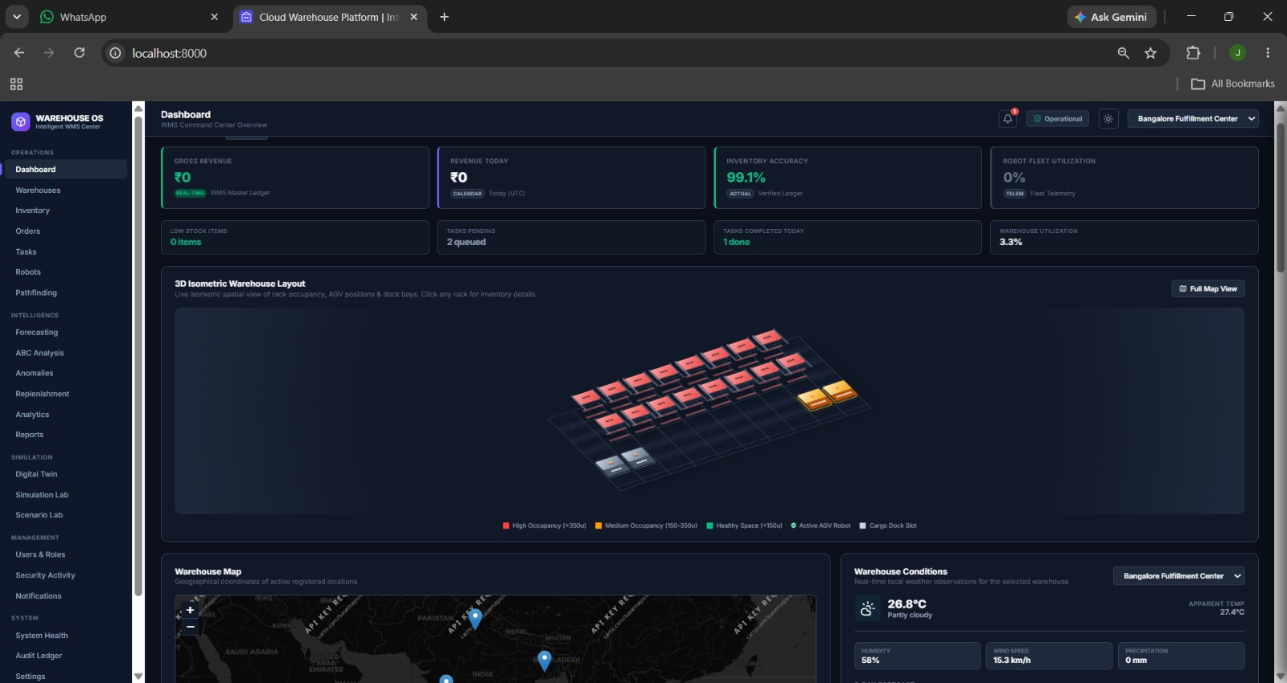
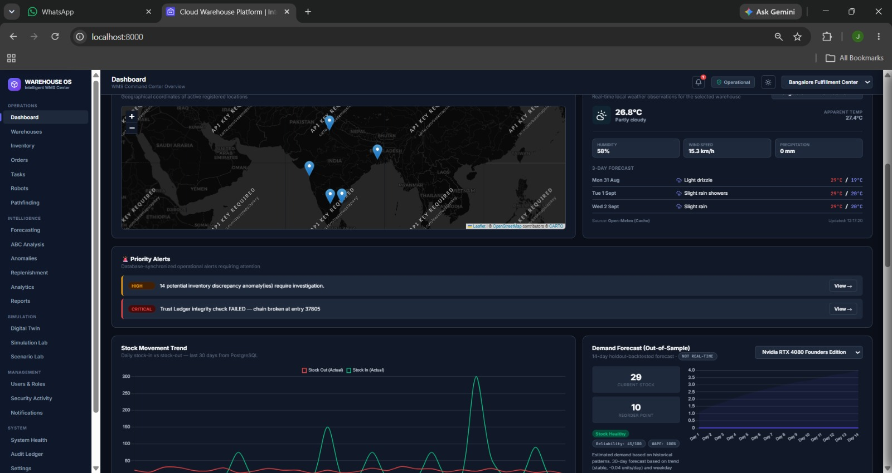
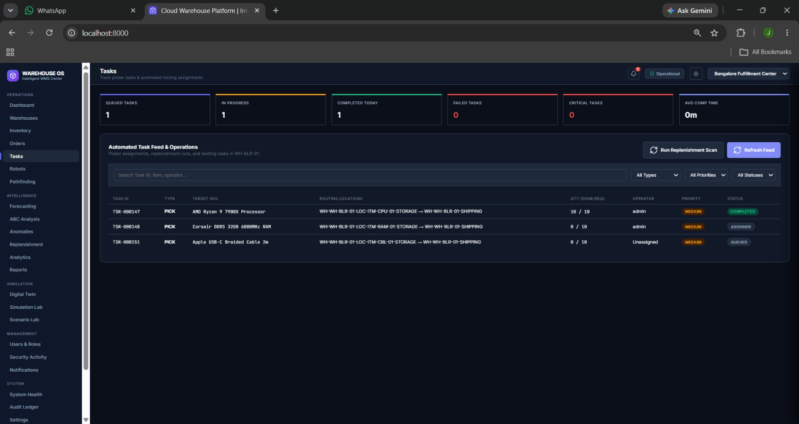
MODULE 1 : OUTPUT

Slide 7
MODULE 2: SECURITY, ACCESS CONTROL & AUDIT
Enforces Role-Based Access Control with granular permissions, bcrypt password hashing, and JWT-based sessions.
Requires step-up OTP verification for sensitive actions, with account lockout after repeated failed login attempts.
Logs every security- and inventory-relevant event to a hash-chained, tamper-evident audit ledger with built-in integrity verification.
Enforces TLS certificate verification on every external service connection, with no unauthenticated mutating endpoints.
Exposes a live system health view and error tracking for every connected service.

Slide 8
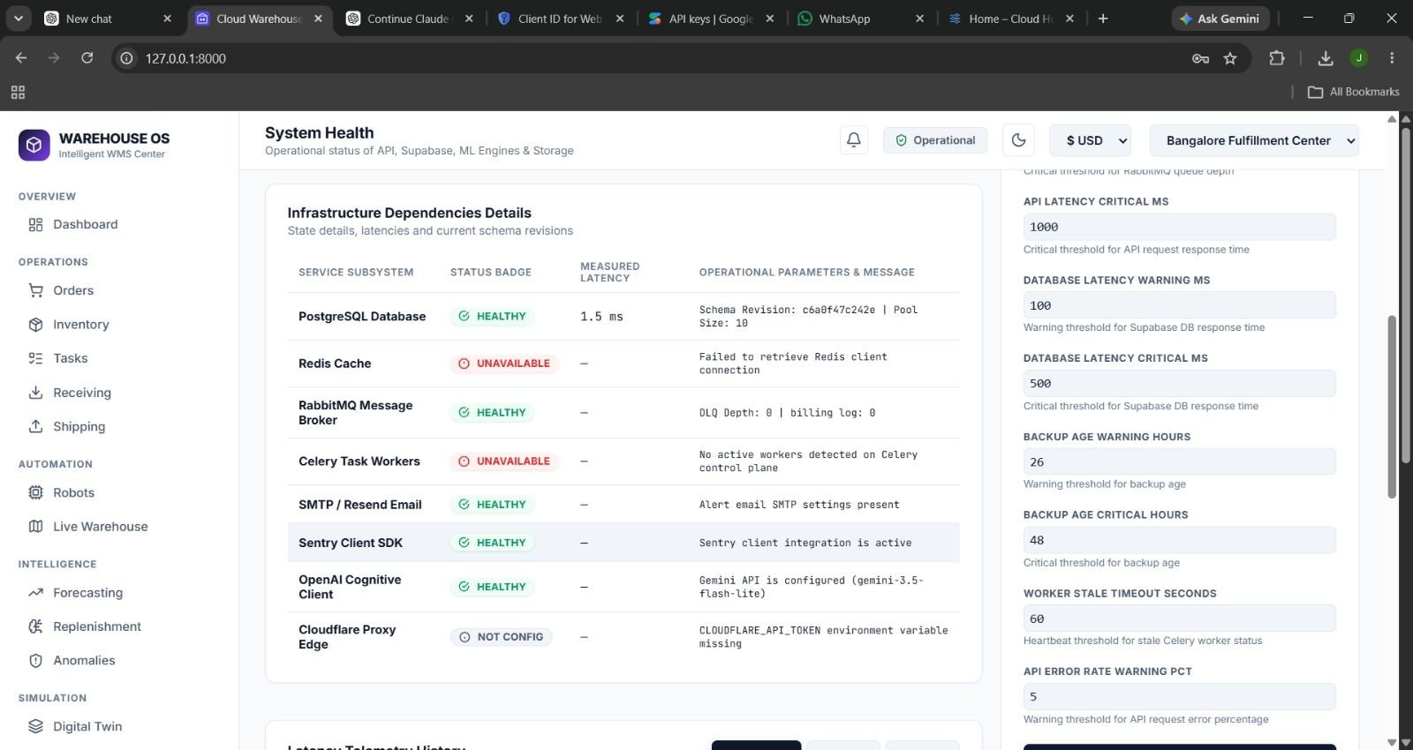
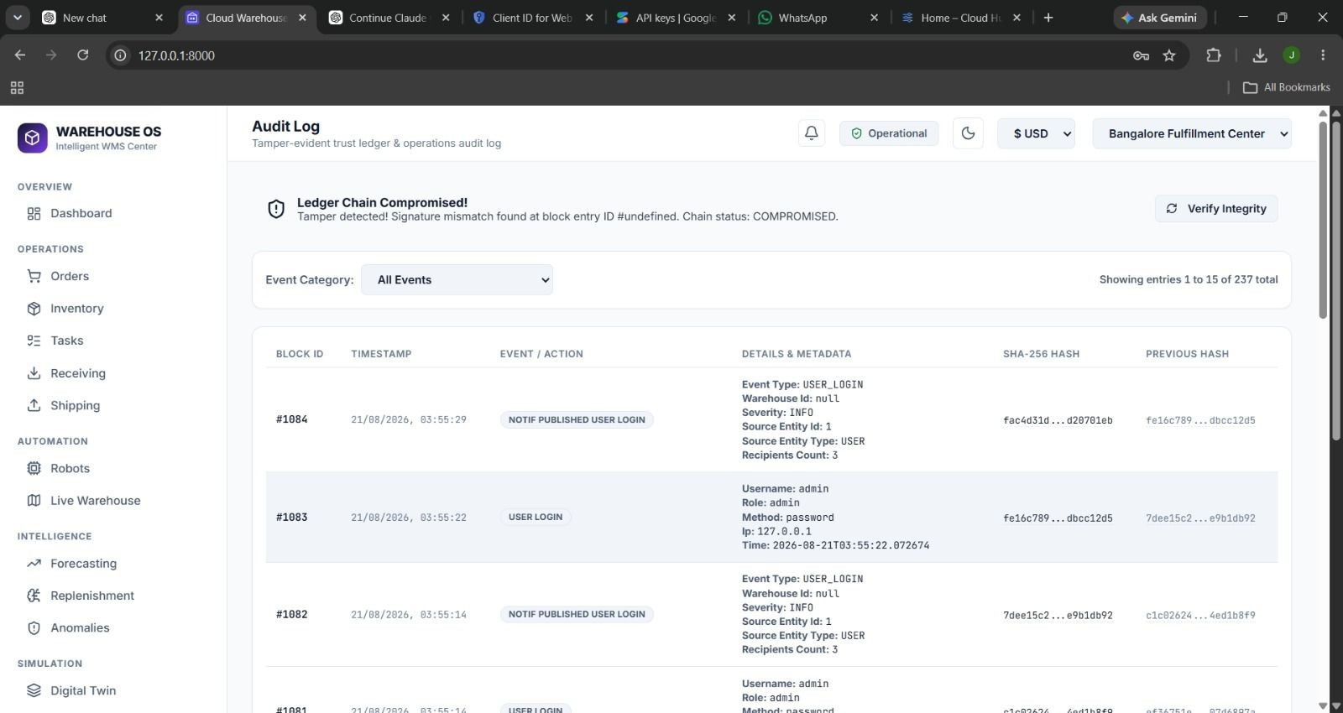
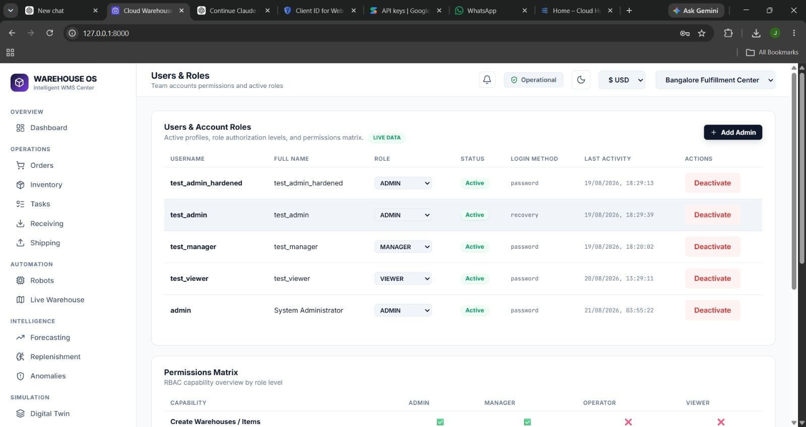
MODULE 2: OUTPUT

Slide 9
MODULE 3: PREDICTIVE INTELLIGENCE & DECISION SUPPORT
Forecasts short-horizon product demand using chronological train/test splits and walk-forward validation against naive baselines.
Scores forecast quality with WAPE, MAE, RMSE, and sMAPE, attaching a composite reliability score to every forecast.
Runs an Isolation Forest model over stock-movement data to flag anomalies that may indicate shrinkage, theft, or damage.
Performs ABC inventory classification and smart replenishment recommendations, layered on top of the core forecasting engine.
Every AI recommendation ships with a plain-language explanation and a human approval step before it is acted on.

Slide 10
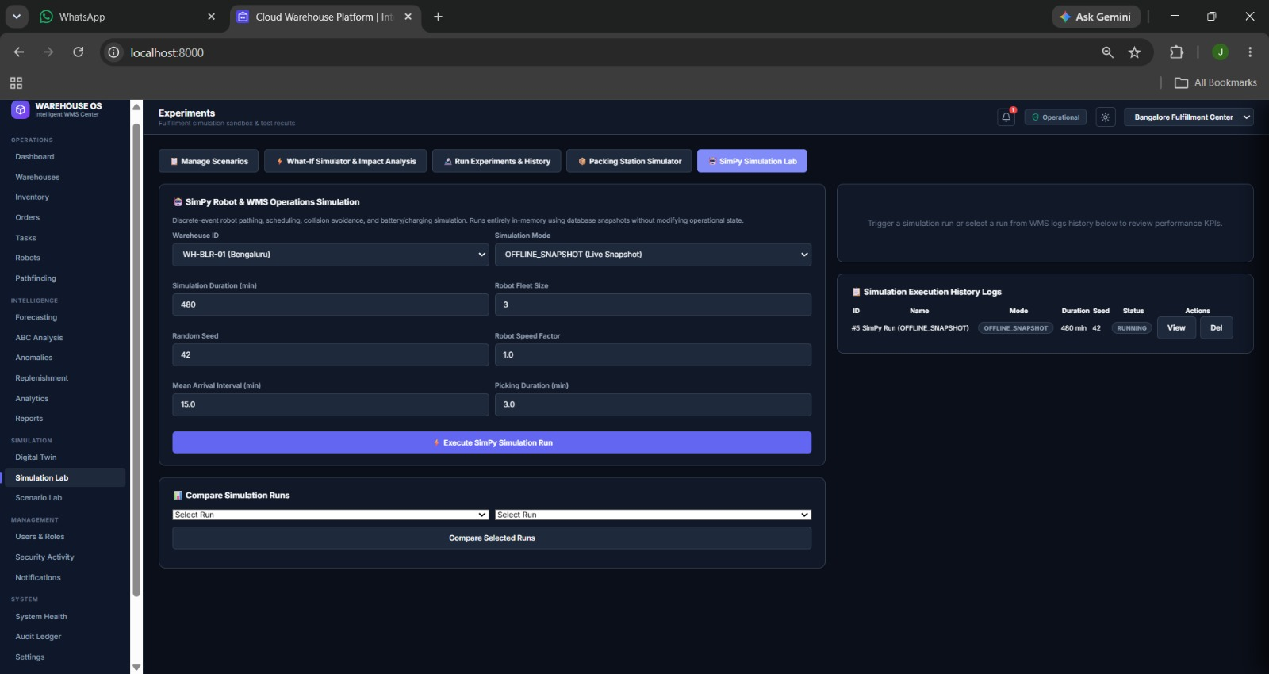
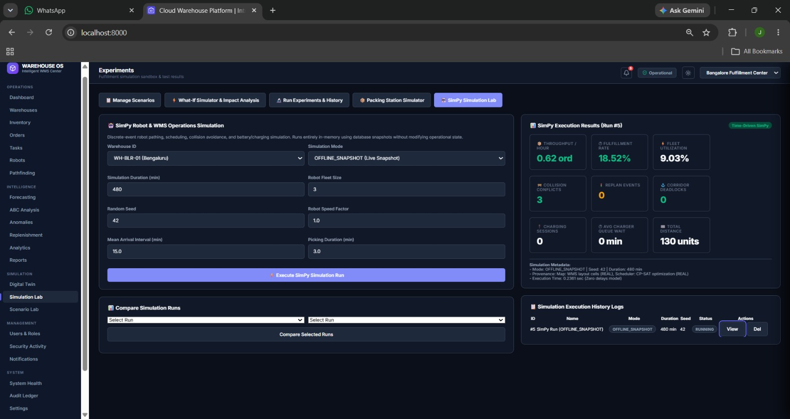
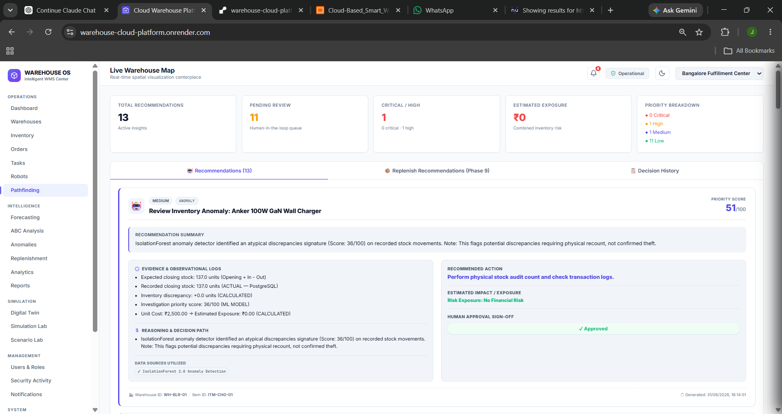
MODULE 3: OUTPUT

Slide 11
MODULE 4: DIGITAL TWIN, SIMULATION & AI ASSISTANT
Maintains a database-reconciled 2D/3D Digital Twin showing live robot positions, routes, obstacles, and warehouse KPIs.
Implements A* pathfinding with a Manhattan-distance heuristic, cell-reservation collision detection, and dynamic replanning.
Provides Start / Pause / Step / Reset simulation controls and a Scenario Lab for reproducible what-if experiments.
Benchmarks robot-task assignment using Google OR-Tools (CP-SAT) and models packing-station throughput with SimPy.
An AI Assistant answers manager queries in natural language, grounded in real warehouse data and access permissions.

Slide 12
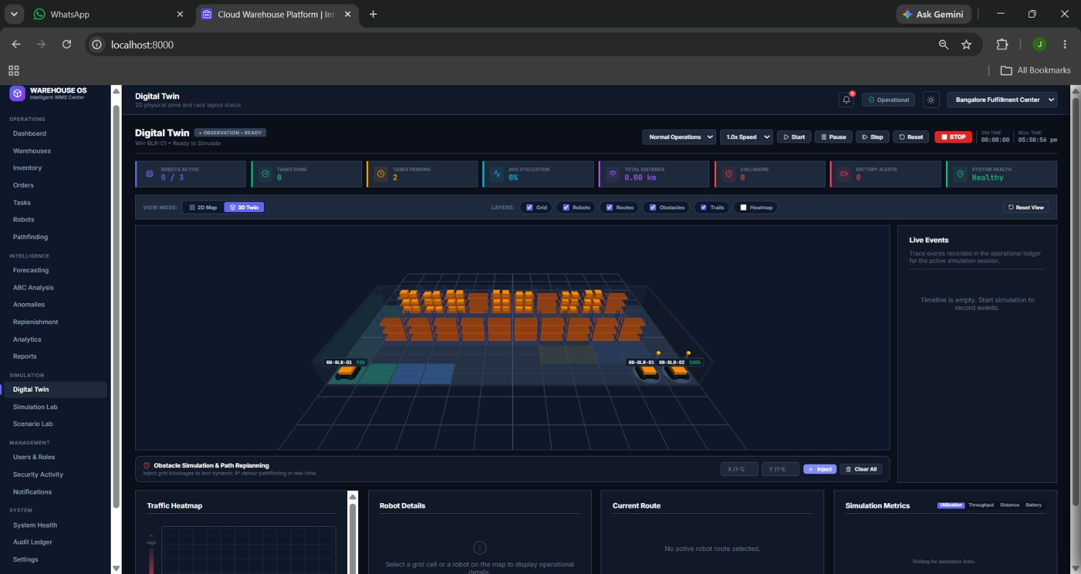
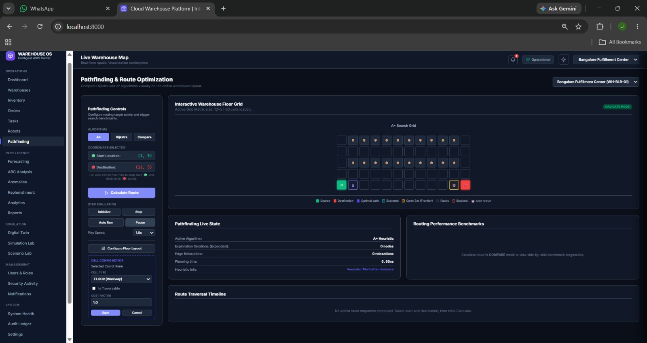
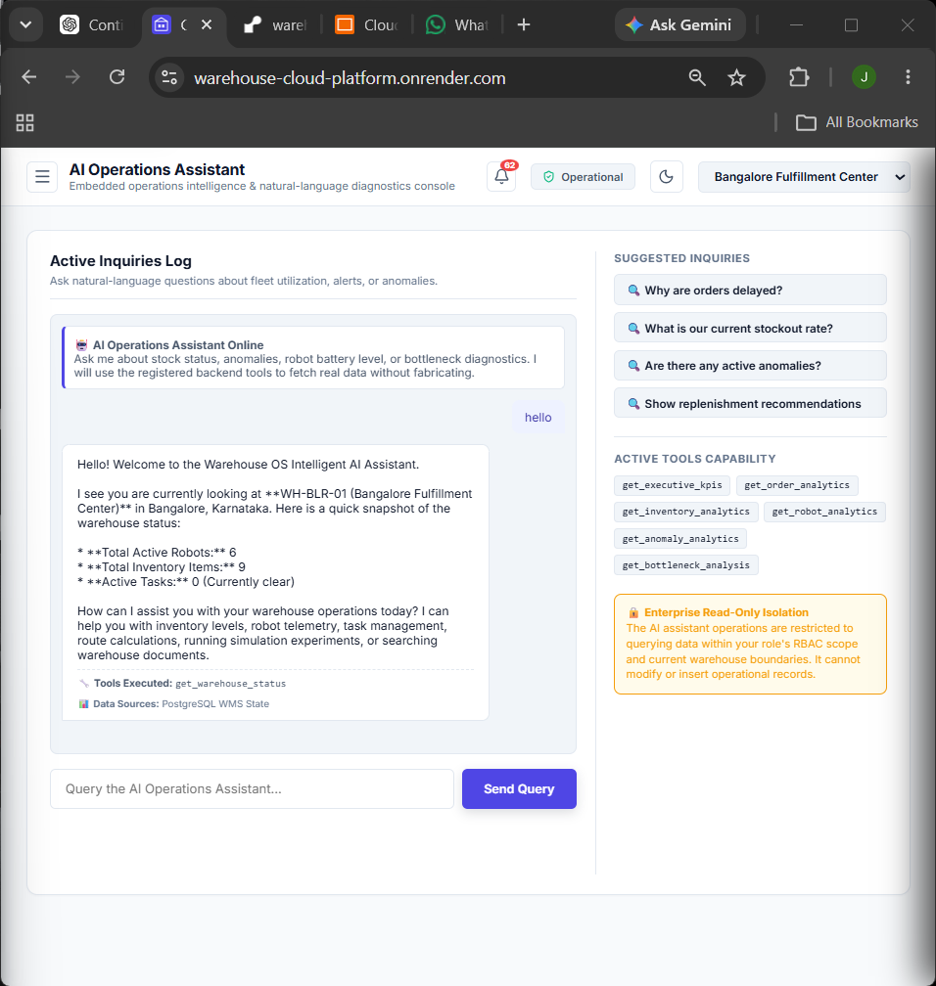
MODULE 4: OUTPUT

Slide 13
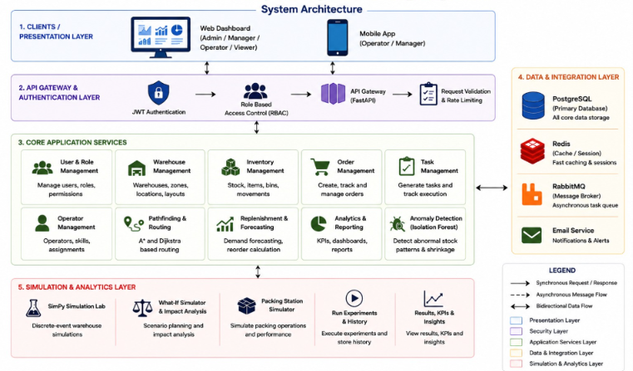
SYSTEM ARCHIECTURE

Slide 14
PROJECT COMPONENT REQUIREMENTS
Hardware Requirements Software Requirements
Intel Core i5 Processor or higher
8 GB RAM
256 GB SSD
Laptop/Desktop with Internet Connection
Cloud Database (PostgreSQL, Render-hosted)
Windows 10/11
Python 3.11+
Visual Studio Code
FastAPI Framework
PostgreSQL / SQLite (testing only)
Core Libraries
Dataset Requirements
SQLAlchemy, Alembic
scikit-learn, pandas, NumPy
Google OR-Tools, SimPy
Synthetic Warehouse Inventory Dataset
Multi-Warehouse Stock-Movement Logs
Simulated Robot Telemetry & Task Events

Slide 15
TASKS
Build the FastAPI backend, PostgreSQL schema, and Alembic migrations for orders, tasks, robots, and inventory.
Implement RBAC, OTP, and the hash-chained audit ledger, and validate every endpoint with automated tests.
Design the warehouse grid, robot fleet model, and A* path-planning engine with collision detection.
Train and validate the demand-forecasting and shrinkage-detection models, and expose them through backend endpoints.
Build the Digital Twin, Scenario Lab, and AI Decision Center frontend, wiring every module end to end.

Slide 16
SPECIFIC PARAMETERS
Robot State: Position, battery level, task assignment, and status (idle / moving / waiting / failed), tracked per tick.
Path Cost: Weighted grid cost combined with the Manhattan heuristic to compute each robot's route.
Product Demand: Historical stock-movement volume used as the basis for the forecast model.
Inventory Deviation: Difference between expected and actual stock levels, used to flag anomaly events.
Task Priority: Composite score combining order urgency, robot cost, and battery level for assignment.

Slide 17
OUTCOME PARAMETERS
Route & Collision Report: Shows generated robot routes and any conflicts resolved through waiting or replanning.
Forecast Reliability Score: Displays demand forecast accuracy against naive and moving-average baselines.
Shrinkage Risk Classification: Classifies flagged anomalies as likely shrinkage, damage, or data error.
Scenario Comparison Report: Compares baseline vs. OR-Tools optimized scheduling across repeated simulation runs.
Audit & System Health Digest: Summarizes ledger integrity status and live connection status of every integrated service.

Slide 18
TECHNIQUES TO BE USED
Robotics & Path Planning: A* search, Manhattan heuristic, cell-reservation collision avoidance.
Machine Learning: Isolation Forest for anomaly detection; walk-forward validated demand forecasting.
Optimization & Simulation: Google OR-Tools (CP-SAT) scheduling and SimPy discrete-event simulation.
Backend & Data: FastAPI for the API layer, SQLAlchemy/PostgreSQL for persistence, Alembic for migrations.
Security & Observability: RBAC, OTP step-up auth, hash-chained audit ledger, live system health tracking.

Slide 19
FUTURE SCOPE
Integrate real IoT/RFID sensors for live robot telemetry instead of simulated data.
Deploy the async task pipeline on live production infrastructure for true background processing at scale.
Improve forecast accuracy using deep-learning models trained on larger historical datasets.
Extend the Digital Twin with richer 3D warehouse visualization and multi-floor support.
Add a native mobile app for warehouse managers with push notifications for critical alerts.

Slide 20
CONCLUSION
The platform delivers a complete, tested warehouse operations core — orders, inventory, and transfers — as its foundation.
Security and auditability are built in from the ground up, not bolted on: RBAC, OTP, and a hash-chained ledger all work end to end.
It forecasts demand and detects shrinkage using explainable, validated machine learning rather than black-box alerts.
The Digital Twin, Scenario Lab, and AI Assistant provide reproducible simulation and natural-language decision support.
Overall, the project delivers a practical, auditable, and reproducible platform for intelligent warehouse automation.

Slide 21
REFERENCES
Bodne, M., Patar, V., Sontakke, S., Turankar, V., & Kale, B. V. (2026). Cloud-Based Inventory Management System: Architecture, Real-Time Analytics, Automation, and Security for Modern Enterprise Supply Chains. International Research Journal of Innovations in Engineering and Technology, 10(5), 241-253.
Bhargav, A., Zope, A. S., Jambhale, M. S., Korde, N. M., & Khan, H. A. (2017). IoT Based Industrial Automation. International Journal of Engineering Research and Technology, 5(1), 821-827.
Olanrewaju, R. F. (2021). Cloud-Based Warehouse System for Effective Management of Under and Over-stock Hazards. ICCCE, pp. 274-278.
Tan, W. C., & Sidhu, M. S. (2022). Review of RFID and IoT Integration in Supply Chain Management. Operations Research Perspectives, 9, 1342-1348.

Slide 22
Thank You

